Slide 1

DriverPass System Analysis
Christopher Phillips
Notes:
Hello and welcome to the DriverPass System Design Overview. My name is Christopher Phillips, but you can call me Chris, and today I will walk you through the key features of our design. We’ll discuss the system requirements, the key use cases, how we ensure security, and any limitations we want to highlight.

Slide 2
System Requirements
Web-based, cloud-hosted solution
Secure role-based login
Real-time reservations and scheduiling
Integration with DMV for updates
Notes:
DriverPass is a cloud-based system that provides on-road training lesson reservations, online classes, and integration with DMV for the latest guidelines. Our users (customers, secretaries, instructors, and admins) log in securely, check schedules, and manage packages. We chose a cloud-based approach so everyone can access the system from any device with internet access.

Slide 3
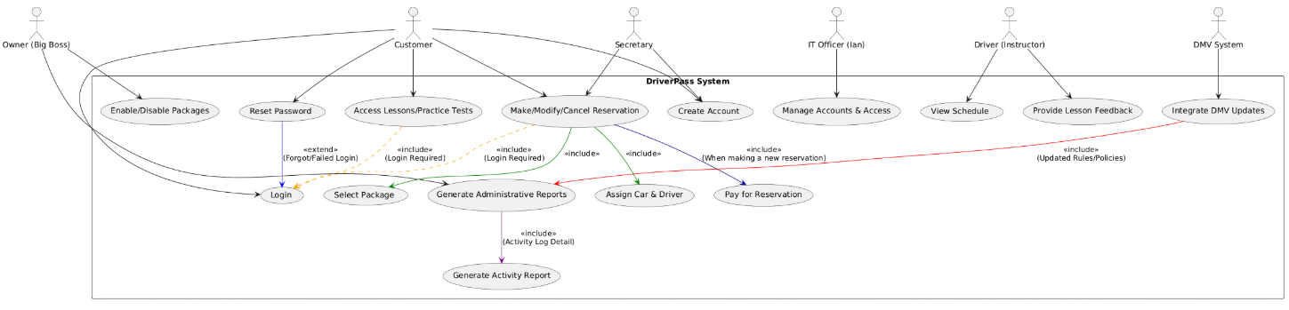
Use Case Diagram
Notes:
This diagram shows how different types of users—customers, owners, instructors, and more interact with the system. Key features include creating accounts, booking or canceling lessons, and generating administrative reports. This visual helps us ensure we’ve captured all major tasks.

Slide 4

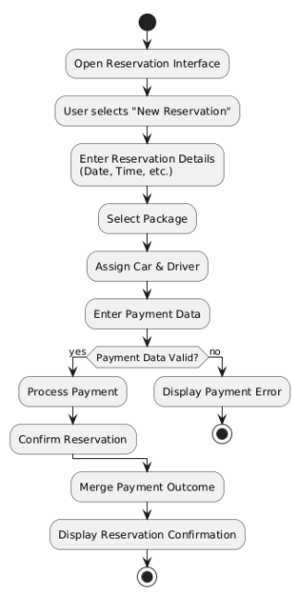
Activity Diagram
Notes:
Here’s an activity diagram for the “Make/Modify/Cancel Reservation” use case. You can see how the process starts with the user requesting a new reservation or updating an existing one. If it’s new, the user selects a package, assigns a driver, and completes payment. This helps us confirm that the system handles all paths smoothly.

Slide 5
Security
Role-based access(Customer, Admin, etc…
Encrypted passwords
HTTPS/SSL for secure data transfer
Audit log for tracking changed
Notes:
We take security very seriously. Each user has a specific role, and the system enforces permissions based on that role. Passwords are stored securely, and all communication with the server is encrypted. Additionally, we keep an audit log so the owner can see who made changes or canceled appointments. This not only protects sensitive data but also helps with accountability.

Slide 6
System Limitations
Offline read-only access only
Future features require developer assistance
Dependent on stable internet connectivity
Notes:
Currently, if a user goes offline, they won’t be able to create or update reservations. They may only view information that’s been cached on their device. Also, if DriverPass decides to add entirely new packages or complex features, a developer has to modify the system behind the scenes. Finally, because our solution is web-based, users do need reliable internet access.

Slide 7

Notes:
Thank you for reviewing our system design. Please let me know if you have any questions or if there are additional features you’d like to discuss. We’re excited to implement this solution and help DriverPass students succeed in their driving tests!

